Slide 1
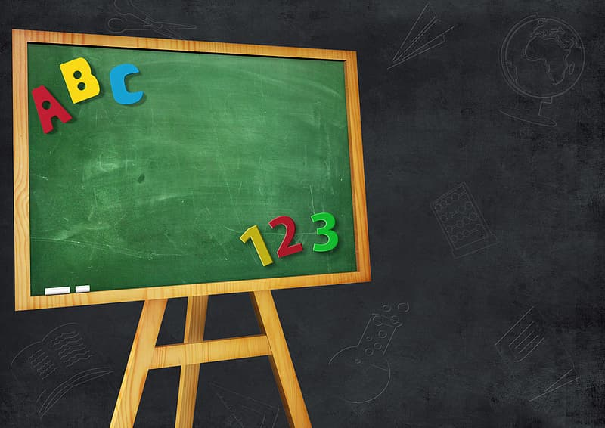


KINDERGARTEN
2019-2020
SCHOLASTIC ACADEMY FOR
ACADEMIC EXCELLENCE

Slide 2
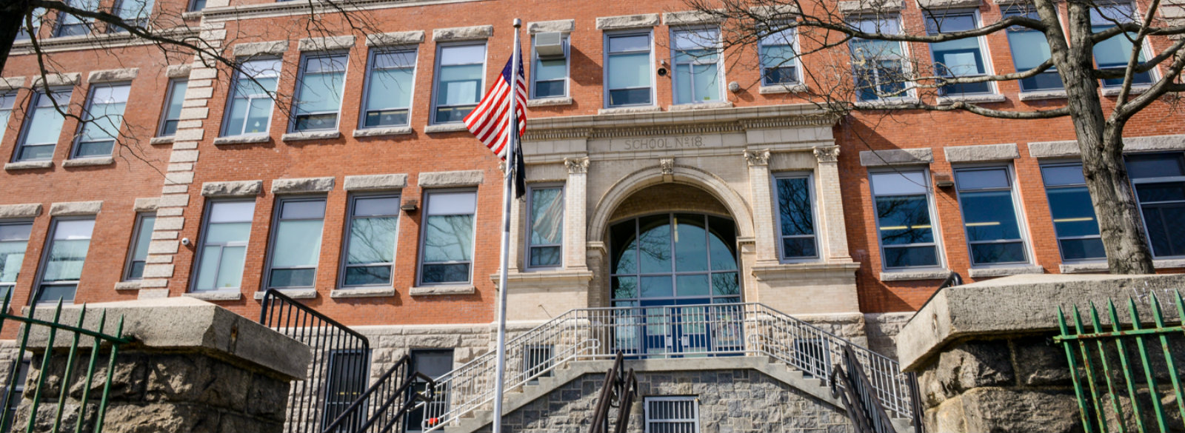
Welcome to our
“Moving Up”
Gallery

Slide 3
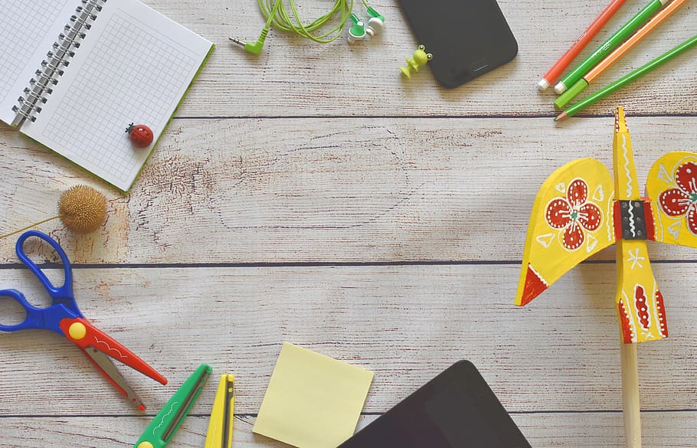
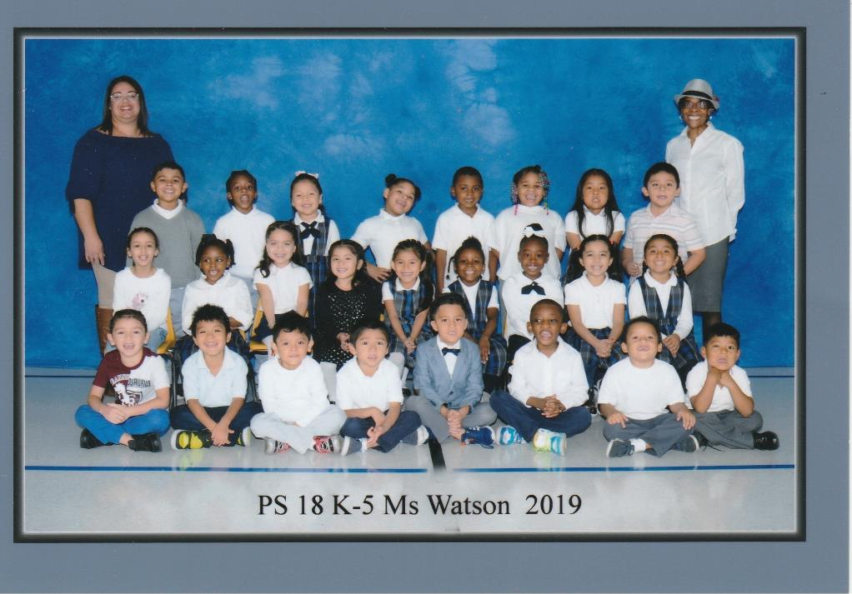

Slide 4
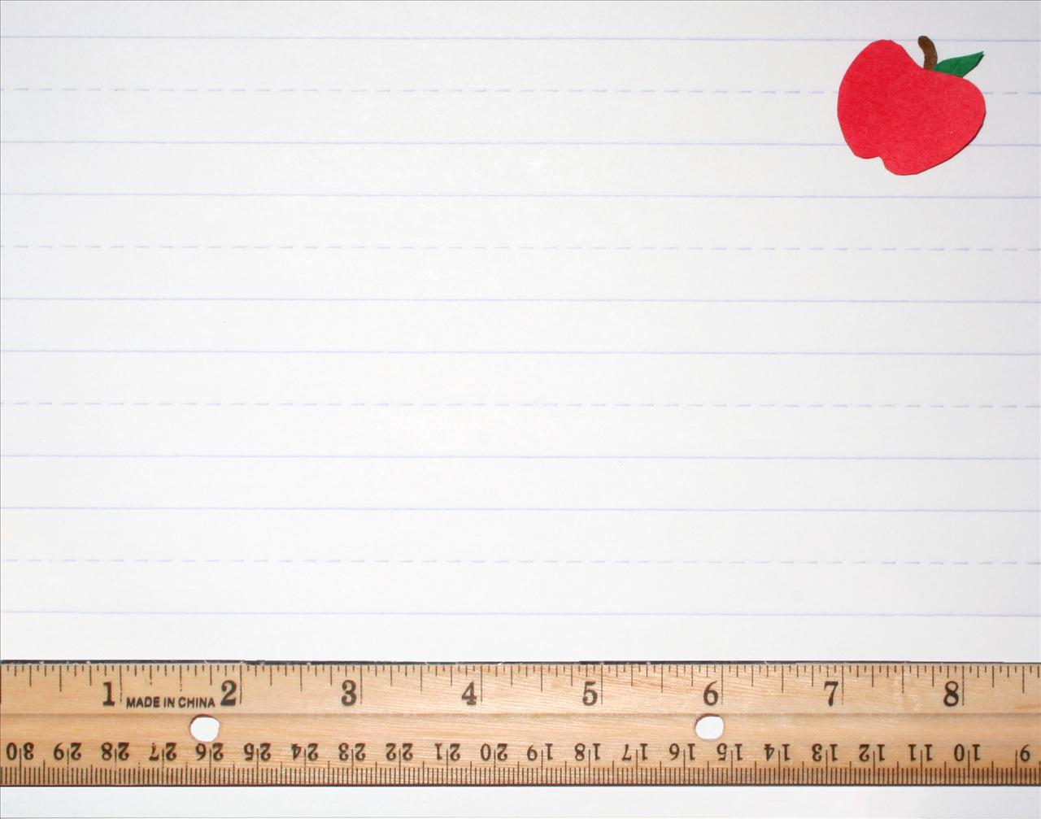
K is for Kindergarten---hip, hip, hooray.
I is for imagination we use everyday.
N is for numbers--we know one, two, three.
D is for drawing, the best you can see!
E is for exercise to keep our bodies strong.
R is for reading books all day long.
G is for good friends. We made more each day.
A is for the alphabet we know how to say.
R is for remembering everything we learned.
T is for treats every Friday we earned.
E is for excitement. This year we've had some.
N is for next year. First grade here we come.

Slide 5

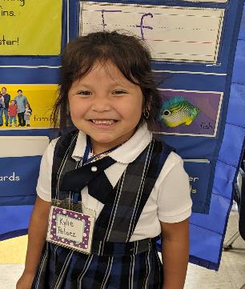
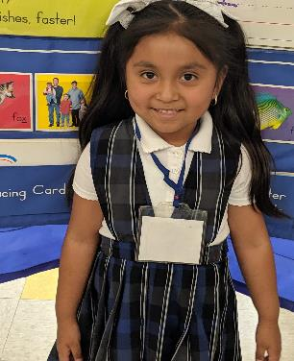
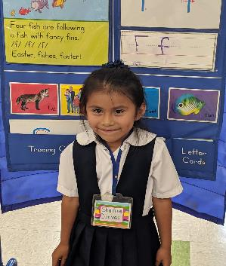
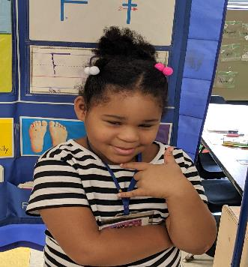
We learned to write sentences.
Kylie
Rachel
Sherine
Ajanah

Slide 6

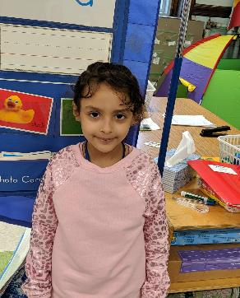
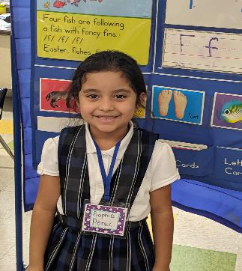
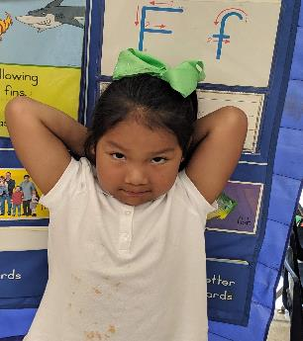
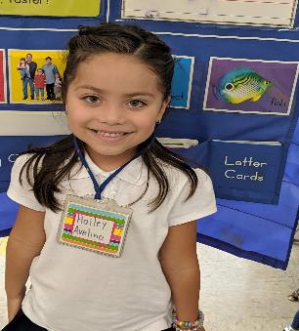
We learned to draw and color, by mixing colors.
Noor
Sophie
Diana
Hailey

Slide 7
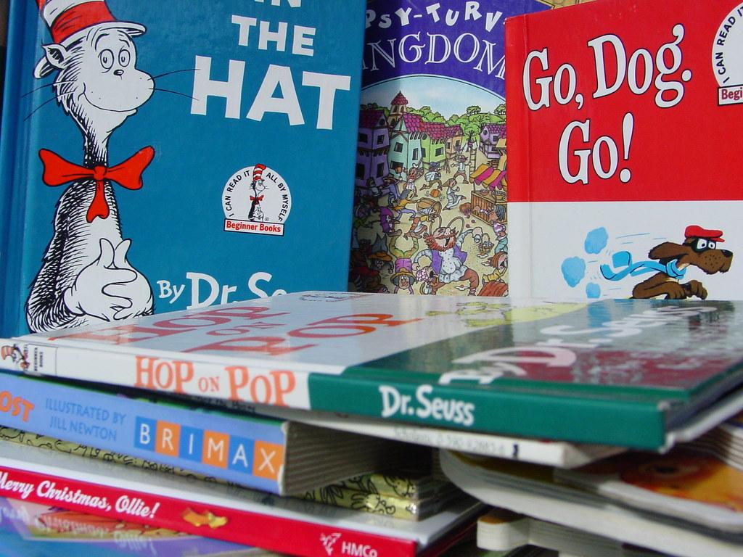
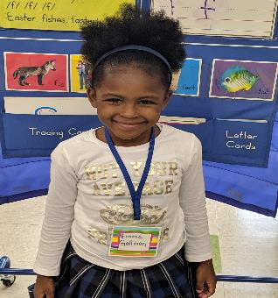
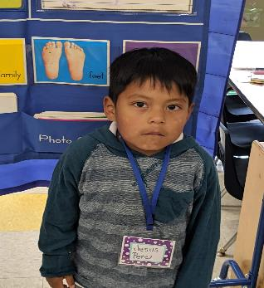
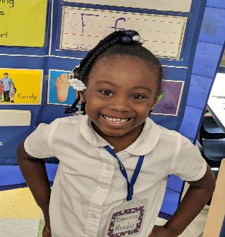
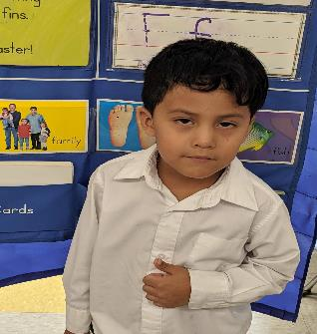
We learned to read.
Emma
Jesus
Daniella
Ronaldo

Slide 8
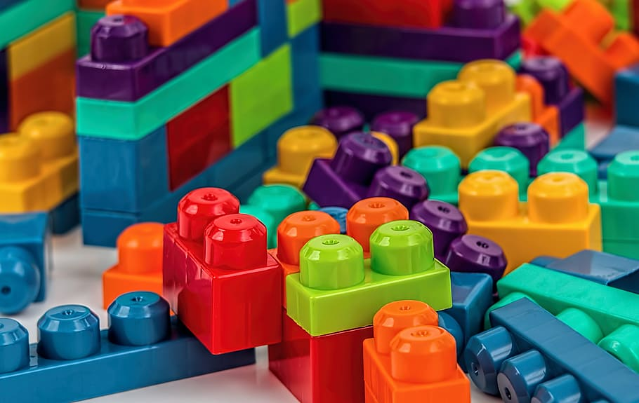
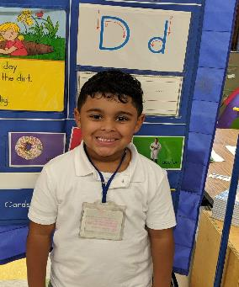
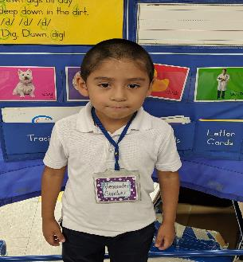
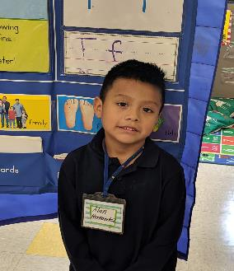
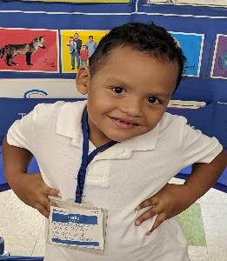
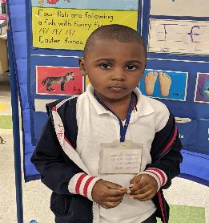
Alexander
Alan
Liam
We learn to build using blocks, and our vocabulary.
David
Sebastian

Slide 9
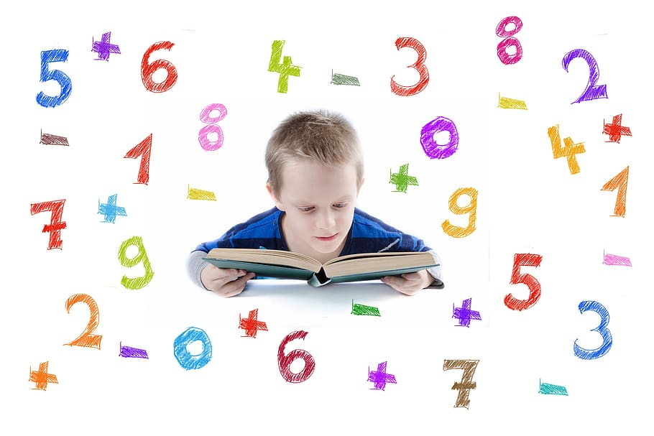
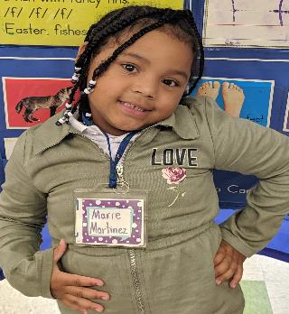
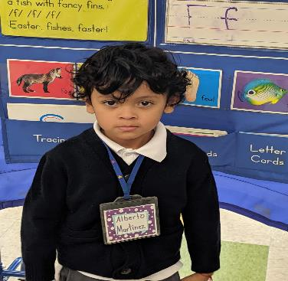
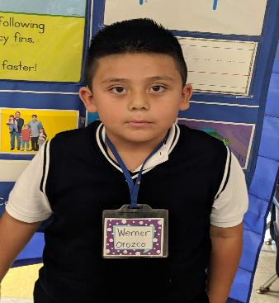
Marie Alberto Werner
We learned to add and subtract

Slide 10
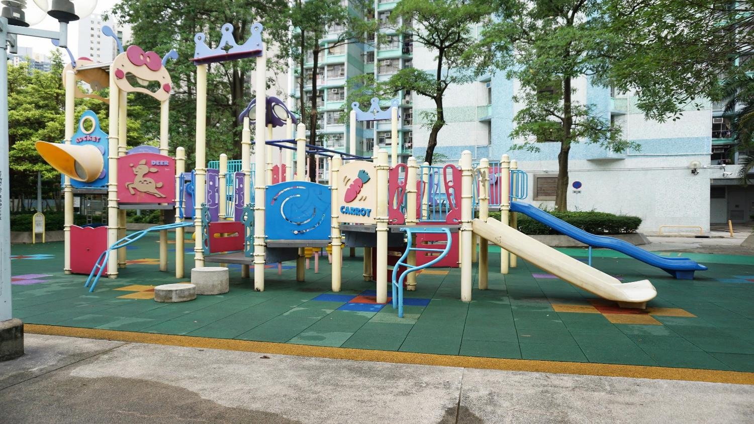
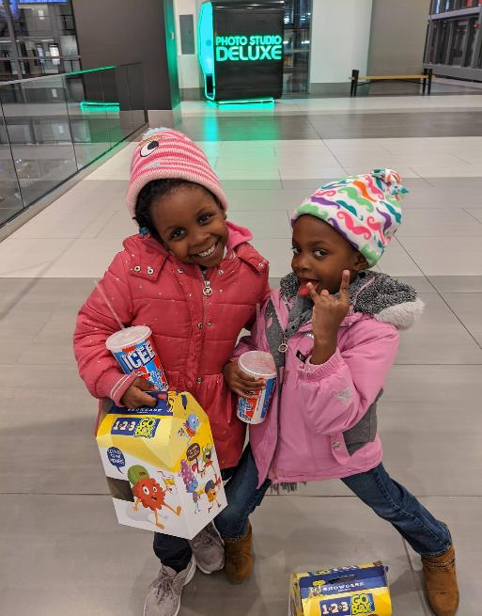
We learned to make new friends.
Savannah and Ajahni

Slide 11

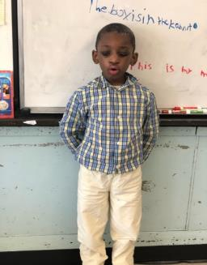
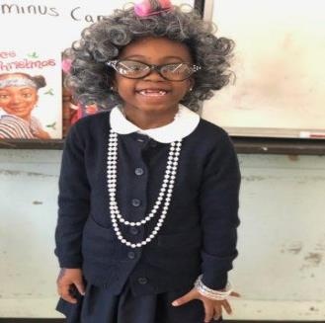
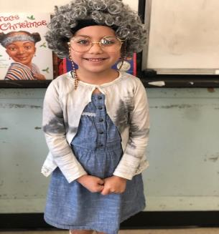
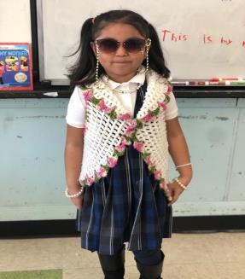
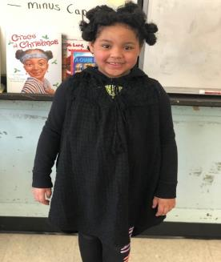
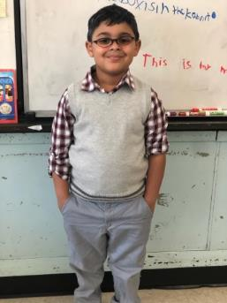
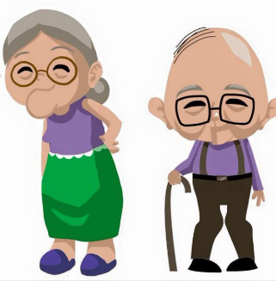
Ms. Watson’s class is 100 Days Smarter
What we would look like when we are 100 years old!

Slide 12
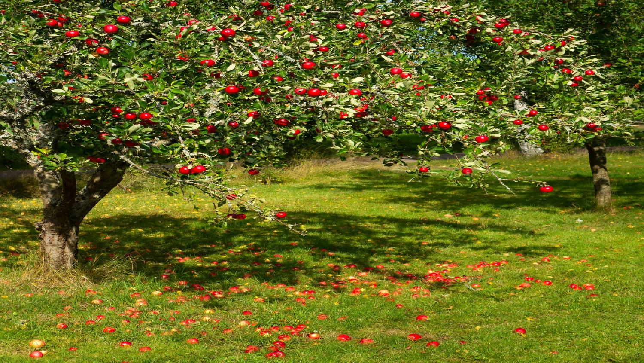
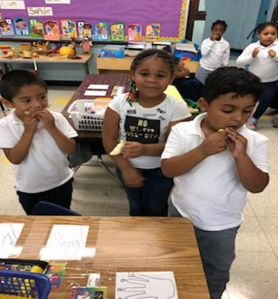
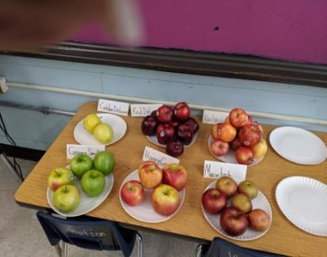
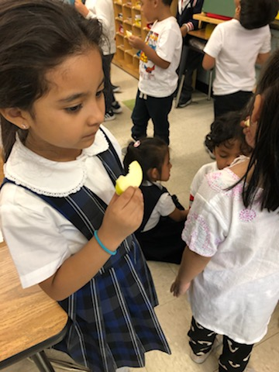
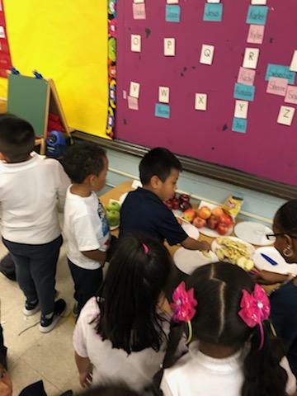
We tasted apples, which do you like best?
That is a sour apple.

Slide 13

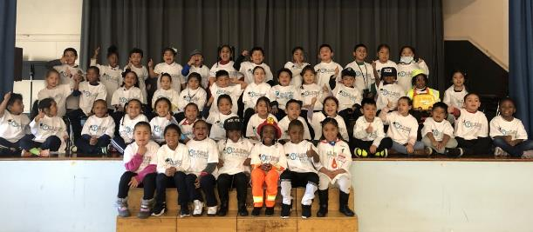
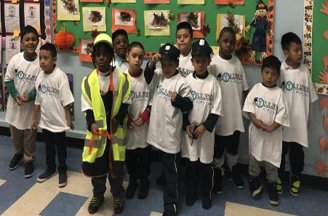
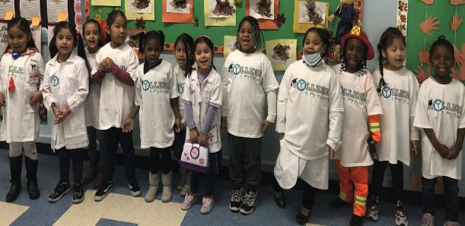
College
is my future

Slide 14

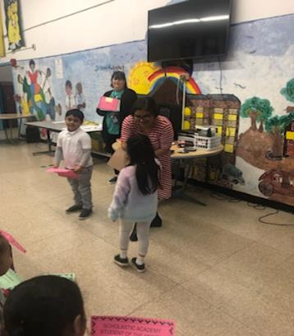
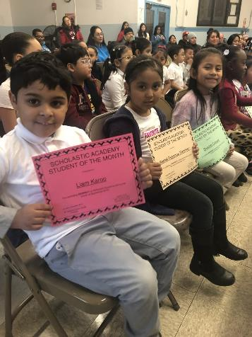
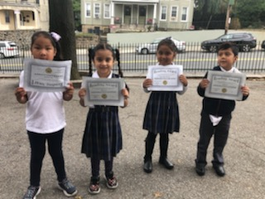
Getting special rewards for doing something extra special at school.

Slide 15

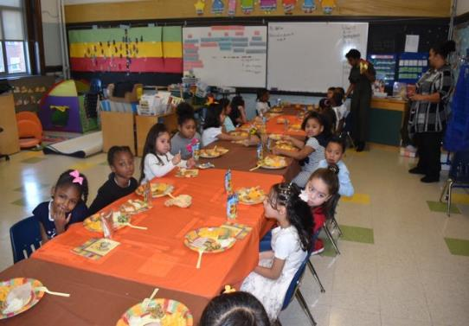
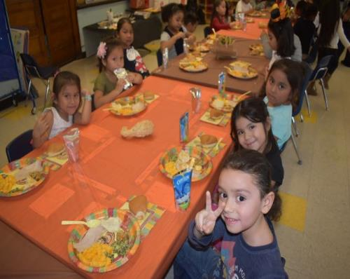


We learn to share and be thankful for friends.

Slide 16



Christmas Concert
Celebrating the Holiday.
We learned to give.

Slide 17


Santa was here!!!

Slide 18





Celebrating Dr Seuss

Slide 19


We fight against bullies, no bullies in K5.

Slide 20


Slide 21



Turn and Talk
Think together with a friend, you’ll have
an answer in the end.

Slide 22



Friends read and share together.

Slide 23




Special guests came to read to us.
Thank You!

Slide 24



OUR ADMINISTRATORS
Dr. Valencia Brown-Wyatt
Principal
Mrs. C. Heid
Assisted Principal

Slide 25


The rooms were all empty
The toys were all put away.
This was not how I expected
your “Moving Up Day”.
You are a very special person
And I want you to know.
How I loved to be your School Aide,
How fast the weeks did go!
In our short time
We laughed, learned and played.
But you are growing up now.
You are going to First Grade!
Please come back to visit me
As through the grades you grow,
Ms. Z will be here to help you with
Everything you must to know.

Slide 26


TO MY K-5 CLASS
The last day of school...the closing of one door and the opening of another. You are now first graders!
To my students: I want to thank each child for all the warmth, the memories,and the learning that we have shared this school year. I want to say THANK YOU! For when I teach
I also learn. This past year, we have faced many challenges,
and have grown through them together. A little bit of each of
you will always be with me. Stop by and say hello, when you
are on your way to first grade. I would love to know how you
are doing. Always strive to be the BEST that you
can be!
To my parents: the last four months was a bit rough, but I thank
you for hanging in there with me. I could not have done it
without you. I thank you for allowing me to be your child’s
teacher. I hope this year was as rewarding to you as it was to
for me. I will love your child always
Ms. L. Watson

Slide 27


